Slide 1
MUF SS19
Neurons and Neural Networks

Slide 2

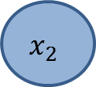


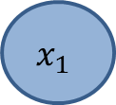


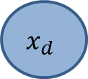

Concept
Input
Output
Activation Function
$$x_{1}$$
$$w_{1}$$
$$x_{2}$$
$$w_{2}$$
$$w,b$$
$φ(w^{T}x+b$)
…
$$w_{d}$$
$$x_{d}$$
with ${w^{T}x+b= w}_{1}⋅x_{1}+w_{2}⋅x_{2}+…w_{d}⋅x_{d}+b, w={(w}_{1},w_{2},{…, w}_{d})$,

Slide 3

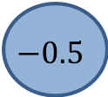

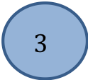

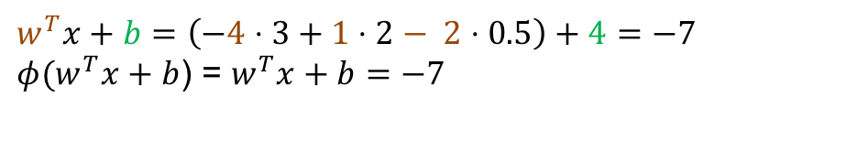

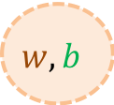
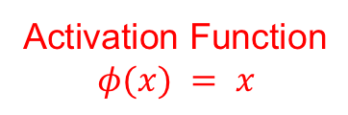
Example (d=3, Bias b = 4)
Input
Output
Activation Function
$$φ(x) = x$$
$$3$$
$$w_{1}=−4$$
2
$$w, b$$
$φ(w^{T}x+b$)
$$w_{2}=1$$
$$w_{3}=2$$
$$−0.5$$
$w^{T}x+b=\left(−4⋅3+1⋅2− 2⋅0.5\right)+4=−7$
$φ(w^{T}x+b$) = $w^{T}x+b=−7$

Slide 4
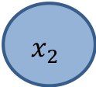


Neural Network Model with one Hidden Layer (d=3)
Input
Hidden
Output
$$x_{1}$$
$$x_{2}$$
pred(x)
$$x_{3}$$
8 Parameters
3 Parameters

Slide 5
Neural Network Model with one Hidden Layer
Input
Hidden
Output
$$x_{1}$$
$$x_{2}$$
pred(x)
pred(x)
$$x_{3}$$
8 Parameters
9 Parameters
4 Parameters

Slide 6
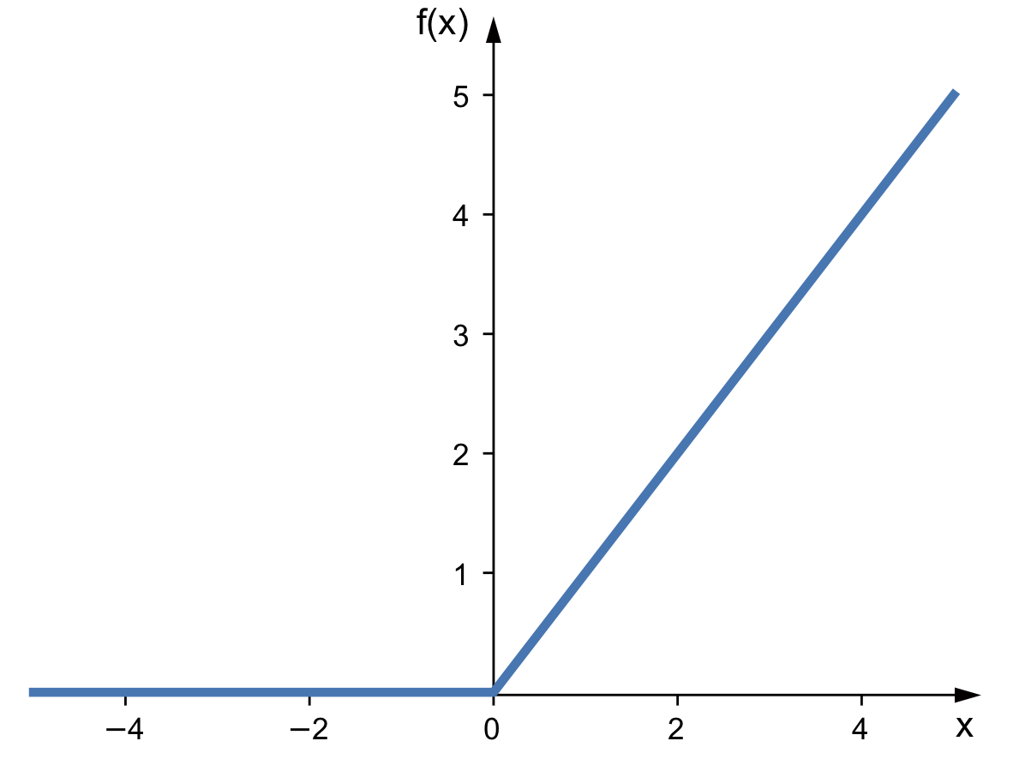


ReLU Activation (Rectified Linear Unit, used for hidden layers)
$$φ(x) =max⁡(0,x)$$
$$φ(x)$$
pred(x)

Slide 7
Play
https://developers.google.com/machine-learning/crash-course/introduction-to-neural-networks/playground-exercises

